Slide 1

AWS in One Day
Custom Course for Touchstone IQ
Presented by Rich Morrow of quicloud.com

Slide 2
Today’s class slides & code are available at: https://github.com/rich-morrow/aws-one-day

Slide 3
Schedule – Day 1
S1: Scenario & Intro (30 mins)
S2: IAM (40 mins)
S3: R53 (30 mins)
BREAK: 15 mins
S4: Load Balancing & WAF (45 mins)
S5: VPC (45 mins)
LUNCH: 60mins
S6: EC2, EBS & AutoScaling (75 mins)
Break (15 mins)
S7: Lambda & Containers (60 mins)
S8: Database options – RDS & DynamoDB (60 mins)

Slide 4
S1: Scenario & Intro
Course outline & objectives
Architecture Scenario
AWS’ Well Architected Framework

Slide 5
Course Outline & Objectives
We WILL teach you:
Some AWS services. Namely: IAM, Route53, ELB (ALB, NLB), WAF, VPC (Subnets, NACLs, Security Groups, VPC Endpoints, Gateways, VPNs), EC2, EBS, AutoScaling, CloudWatch (Alarms, Logs), CloudTrail, S3, Lambda, Containers (EKS, ECS), RDS, DynamoDB
We WILL NOT teach you:
In-depth AWS usage for ANY of these services (this is a ONE DAY course, after all….)

Slide 6





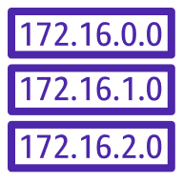





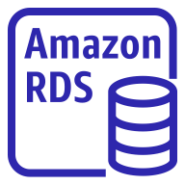
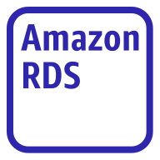
Architecture
Internet
Internet gateway
VPC
Availability Zone 1
Availability Zone 2
NAT Gateway
NAT Gateway
Route table
Public subnet
Application Load Balancer (running WAF)
Public subnet
Route table
Auto Scaling group
EC2 Instance*
EC2 Instance*
Route table
Private subnet
Private subnet
Route table
RDS instance
primary
RDS instance
2ndary
Synchronous Replication
Route table
Route table
Protected subnet
Protected subnet
* - Could be running Lambda -OR- Containers in place of EC2
Notes:
We’ll walk through this architecture, step-by-step throughout the day, hitting on the highlights as we peel back the covers to look at each component individually.

Slide 7
AWS’ Well Architected Framework
Architectural best-practices across six domains that *every* AWS pro should know and love.
“The Pillars”:
Operational Excellence | Security | Reliability / Fault Tolerance
Performance Efficiency | Cost Optimization | Sustainability

Slide 8
S2: IAM
Overview of IAM: Users, Groups, Roles; Credentials; Policy Documents
Resource vs Identity-based Policies
Policy Simulator
Temporary credentials vs long term
MFA
IAM + Tags

Slide 9
Architecture
IAM CONTROLS ACCESS
TO ALL THIS STUFF!!!
Internet
Internet gateway
VPC
Availability Zone 1
Availability Zone 2
NAT Gateway
NAT Gateway
Route table
Public subnet
Application Load Balancer (running WAF)
Public subnet
Route table
Auto Scaling group
EC2 Instance*
EC2 Instance*
Route table
Private subnet
Private subnet
Route table
RDS instance
primary
RDS instance
2ndary
Synchronous Replication
Route table
Route table
Protected subnet
Protected subnet
* - Could be running Lambda -OR- Containers in place of EC2
Notes:
We’ll walk through this architecture, step-by-step throughout the day, hitting on the highlights as we peel back the covers to look at each component individually.

Slide 10
IAM: Holistic AuthN & AuthZ
IAM providess internal CRUD-plane access to infrastructure
AuthZ via: Policy Documents
AuthN via: Credentials
AK/SK: Allows Access to CLI/SDK/REST API
Uname / Password: Allows Access to Web Console
(Optionally) MFA

Slide 11






IAM: High Level
have
AK/SK
(long term)
STS
(short term)
User
App
Role
Credentials
have
Principals
A Principal accesses a Resource (via SDK, CLI, Console or REST API)
Credentials are validated
Permissions (both principal and/or Resource) are checked
Access is granted or denied
CloudTrail (if enabled) logs outcome
Policy Document
Permissions
Notes:
NOTE: This is GREATLY simplified! Policy evaluation logic is a whole lot more complex in AWS. Here’s the skinny: https://docs.aws.amazon.com/IAM/latest/UserGuide/reference_policies_evaluation-logic.html

Slide 12
Policy Document examples
Allow all S3, DDB API calls for 2022 Q1
{
"Statement": [
{
"Effect": "Allow",
"Action": “s3:*,dynamodb:*",
"Resource": "*",
"Condition": {
"DateGreaterThan": {"aws:CurrentTime": "2022-01-01T00:00:00Z"},
"DateLessThan": {"aws:CurrentTime": "2022-03-31T23:59:59Z"}
}
}
]
}
AWS Policy Generator
REQUIRED
OPTIONAL
Allow attach/detach of EBS volume to specific EC2
{
"Statement": [
{
"Effect": "Allow",
"Action": [“ec2:AttachVolume", “ec2:DetachVolume“],
"Resource": [ "arn:aws:ec2:*:*:volume/*", "arn:aws:ec2:*:*:instance/*" ],
"Condition": {
"ArnEquals": {"ec2:SourceInstanceARN": "arn:aws:ec2:*:*:instance/instance-id"}
}
}
]
}

Slide 13
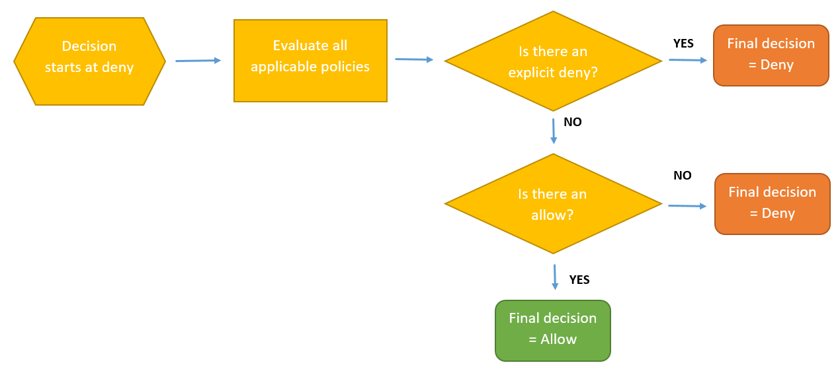
(Very) Basic Policy Eval Logic

Slide 14
STS Roles in IAM
User-configurable (15m – 36h) forced expiration (temporary access ONLY)
Behind Federated access (internal users – SAML, SSO, AD/LDAP), Amazon Cognito (end users), Roles (esp EC2, ECS/EKS [svc and task], Lambda), S3/CloudFront short-term signed URLs & other time-limited AWS access.
Preferred over long term AK/SK credentials
More secure
Roles need no hardcoded credentials

Slide 15
Tags in AWS
Tags are just “key : value” pairs. Like: “owner : me@email.com” that we assign to resources (like EC2).
They serve 4 main purposes:
Access Control: Tag an EC2 with “env = prod” & then set Developers group to DENY all actions on “env != dev”.
Filtering: Tag your Lambdas with “owner = me@email.com” & then quickly find your handful of functions in the console.
Billing: Tag your resources with “cost-center = application-xyz” & then roll up total AWS costs for just your app.
Automation: Tag an EBS disk with “grc-level = pci-1” & then set up automation to ensure all these tagged disks are encrypted.

Slide 16
Using Tags effectively
AWS allots 50 tags / resource
Use 10-15 for company wide purposes (billing, access control, escalations to resource owner, etc)
Use remainder for application or department-specific needs
Creating (and enforcing) a tag topology is job #1 in AWS!!!
Enforcement can happen at resource creation time -AND- on an ongoing basis.

Slide 17
S3: Route53
Overview of DNS
R53 Basics: Domain Registration; API interface; GLB
Routing Policies

Slide 18
Architecture
Internet
Internet gateway
VPC
Availability Zone 1
Availability Zone 2
NAT Gateway
NAT Gateway
Route table
Public subnet
Application Load Balancer (running WAF)
Public subnet
Route table
Auto Scaling group
EC2 Instance*
EC2 Instance*
Route table
Private subnet
Private subnet
Route table
RDS instance
primary
RDS instance
2ndary
Synchronous Replication
Route table
Route table
Protected subnet
Protected subnet
* - Could be running Lambda -OR- Containers in place of EC2
Notes:
We’ll walk through this architecture, step-by-step throughout the day, hitting on the highlights as we peel back the covers to look at each component individually.

Slide 19
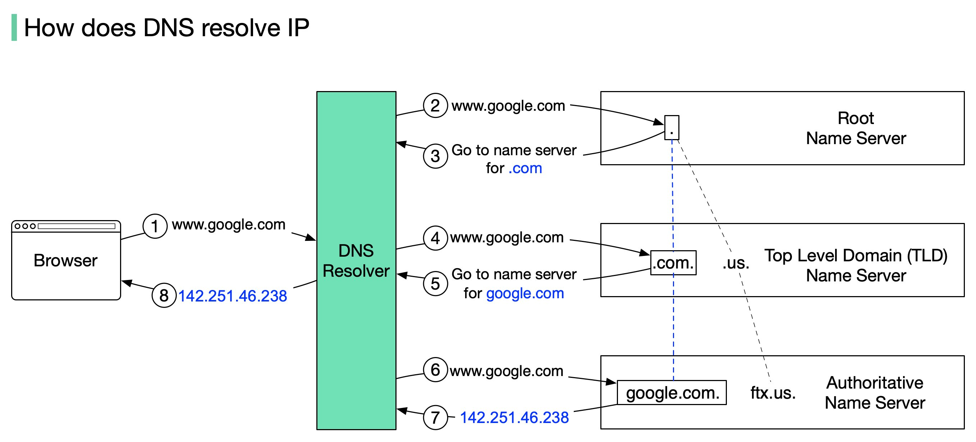
DNS: a Distributed Phone Book

Slide 20
Route 53 Basics
Can register & transfer domains over an API!
Can do private & public DNS
Has an (optional) DNS firewall
Can do healthchecks, live-live, primary/2ndary
Only option for a Global Load Balancer
Primary option for Blue/Green deployments

Slide 22
R53 Routing Policies
Simple
Failover
Geolocation / Geoproximity (down to state level)
Latency based routing
Multivalue
Weighted RR

Slide 23


Slide 24
S4: Load Balancing and WAF
ELB Basics
Walkthrough of the 4 types
WAF Usage
WACL walkthrough
automation possibilities with Lambda
Use with Firewall Manager

Slide 25
Architecture
Internet
Internet gateway
VPC
Availability Zone 1
Availability Zone 2
NAT Gateway
NAT Gateway
Route table
Public subnet
Application Load Balancer (running WAF)
Public subnet
Route table
Auto Scaling group
EC2 Instance*
EC2 Instance*
Route table
Private subnet
Private subnet
Route table
RDS instance
primary
RDS instance
2ndary
Synchronous Replication
Route table
Route table
Protected subnet
Protected subnet
* - Could be running Lambda -OR- Containers in place of EC2
Notes:
We’ll walk through this architecture, step-by-step throughout the day, hitting on the highlights as we peel back the covers to look at each component individually.

Slide 26
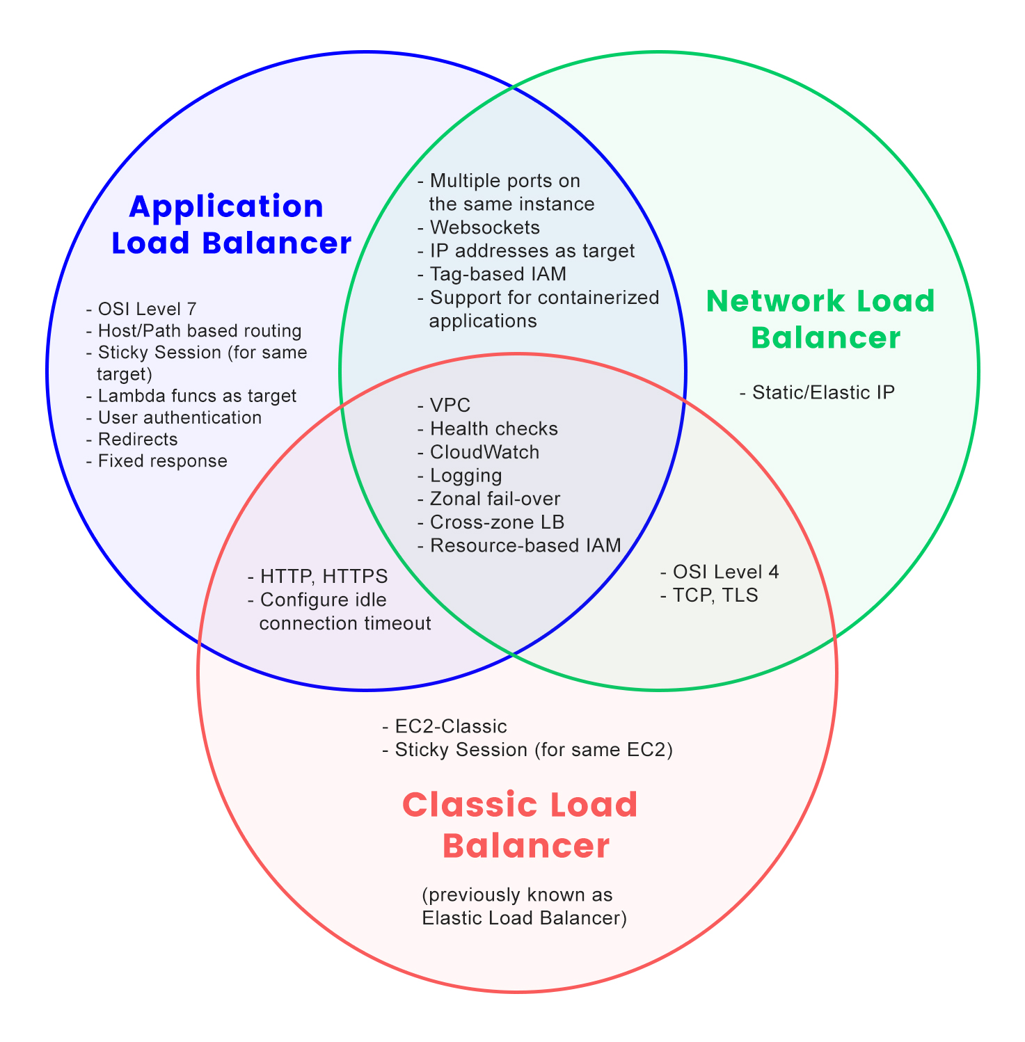

ELB (is actually 4 LBs)
You’ll use this 95% of the time
You’ll use this 5% of the time
If you ever use this…
The 4th type (Gateway LB)
is only for very, very picky, typically misguided enterprise customers

Slide 27

WAF: your 1st line of defense
AWS Managed, Marketplace (paid) & Custom rules
WAF can then be applied to:
ALB
CloudFront (the CDN)
API Gateway
Can run in “dry run” (notify only) mode
Common rule types: OWASP Top 10, CMS, CVE, SQL Injection, Cross-Site Scripting, Bot Control
Works with Organizations (via Firewall Manager)

Slide 28
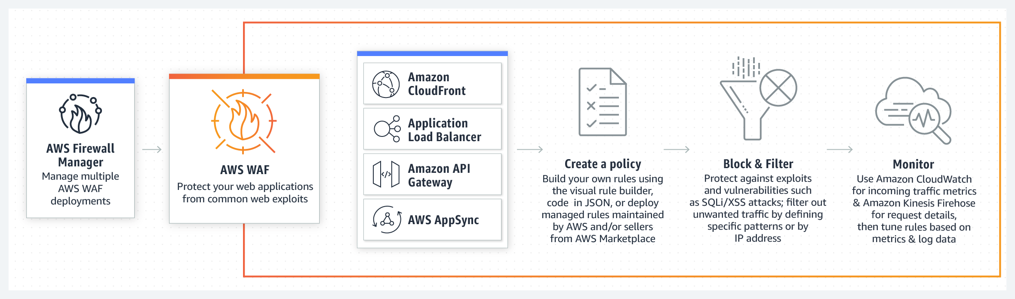
WAF: How it Works

Slide 29
WAF Example
Let’s look at an advanced example right on the AWS site…

Slide 30
S5: VPC
VPC Basics
CIDR Notation
Subnets (public, private, protected), NACLs, Security Groups
Gateways: Internet Gateway, VPN Gateway
VPC Endpoints

Slide 31
Architecture
Internet
Internet gateway
VPC
Availability Zone 1
Availability Zone 2
NAT Gateway
NAT Gateway
Route table
Public subnet
Application Load Balancer (running WAF)
Public subnet
Route table
Auto Scaling group
EC2 Instance*
EC2 Instance*
Route table
Private subnet
Private subnet
Route table
RDS instance
primary
RDS instance
2ndary
Synchronous Replication
Route table
Route table
Protected subnet
Protected subnet
* - Could be running Lambda -OR- Containers in place of EC2
Notes:
We’ll walk through this architecture, step-by-step throughout the day, hitting on the highlights as we peel back the covers to look at each component individually.

Slide 32
CIDR: Shorthand for IP ranges
Common CIDR blocks… who can tell us what each of these mean?
0.0.0.0/0
192.168.0.0/24
1.2.3.4/32
5.4.3.2/29
200.100.50.20/16

Slide 33
VPCs, Subnets, R/Ts
VPC
Availability Zone 1
Availability Zone 2
Route table
Public subnet
Public subnet
Route table
Route table
Private subnet
Private subnet
Route table
Route table
Route table
Protected subnet
Protected subnet
Notes:
Let’s draw in each of these components & discuss in detail

Slide 34
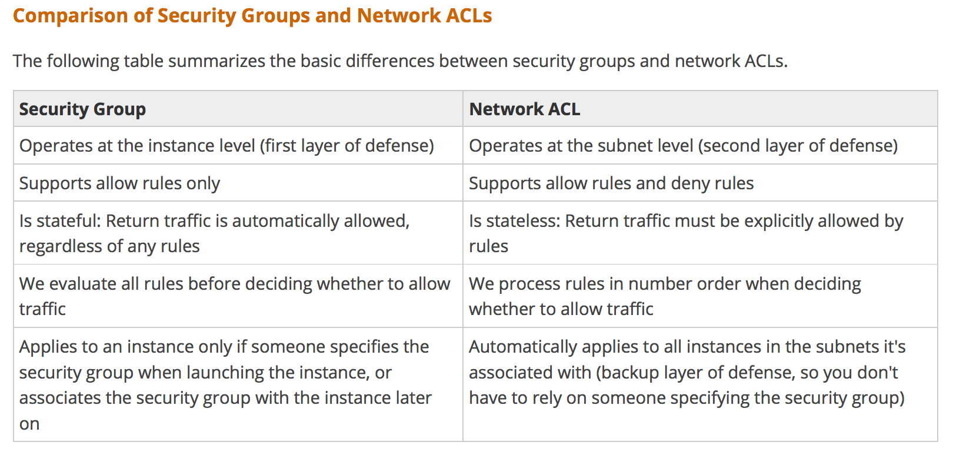
SGs & NACLs

Slide 35
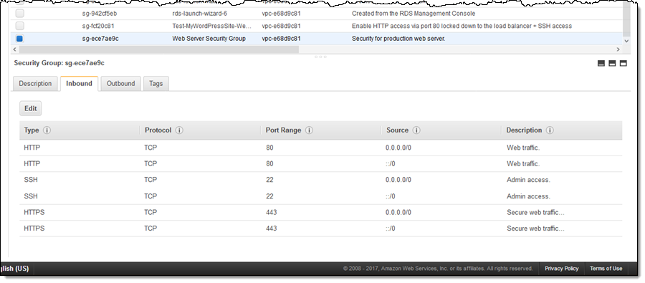
Security Group Example

Slide 36
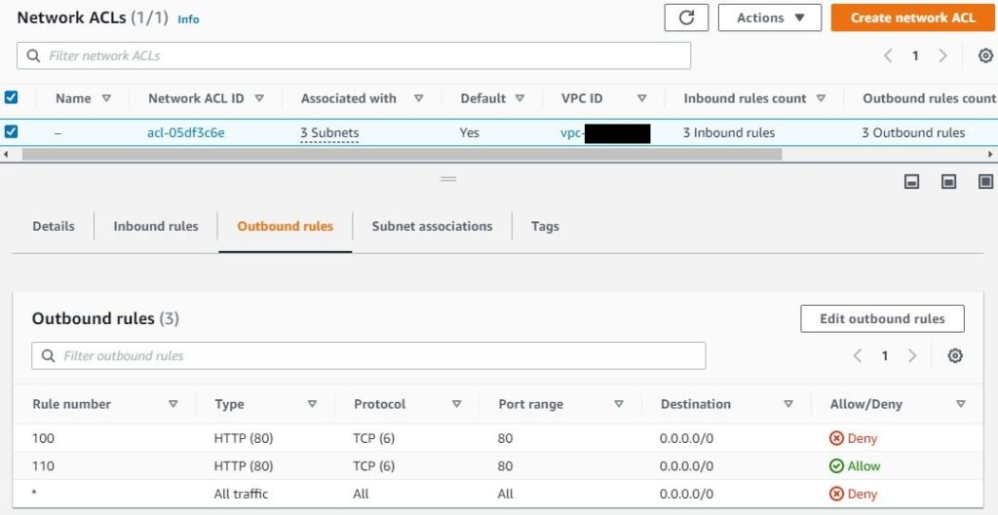
NACL Example

Slide 37
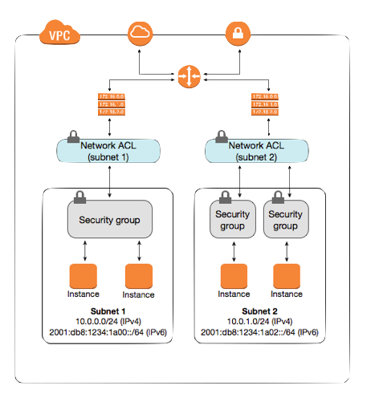
Knowledge Check…

Slide 38
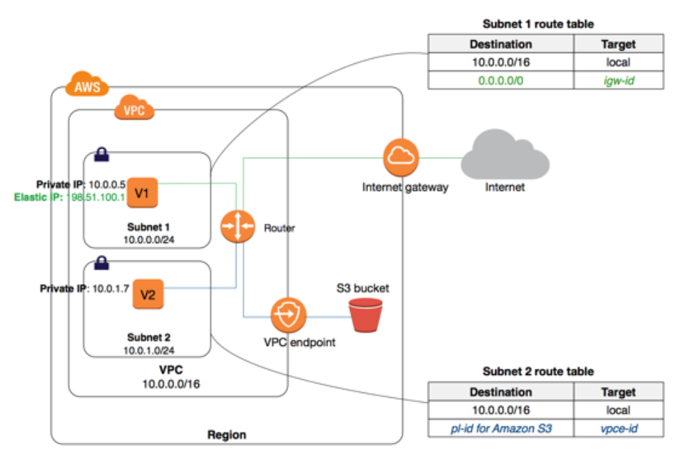
IG vs VPC Endpoint

Slide 39


Slide 40
S6: EC2, EBS, AutoScaling
EC2
AMI, Instance Types
UserData, Instance Metadata service
EBS vs instance storage
EC2 vs Containers vs Lambda
AutoScaling
Launch Template / Configuration
ASG
ASP & CloudWatch Alarms

Slide 41
Architecture
Internet
Internet gateway
VPC
Availability Zone 1
Availability Zone 2
NAT Gateway
NAT Gateway
Route table
Public subnet
Application Load Balancer (running WAF)
Public subnet
Route table
Auto Scaling group
EC2 Instance*
EC2 Instance*
Route table
Private subnet
Private subnet
Route table
RDS instance
primary
RDS instance
2ndary
Synchronous Replication
Route table
Route table
Protected subnet
Protected subnet
* - Could be running Lambda -OR- Containers in place of EC2
Notes:
We’ll walk through this architecture, step-by-step throughout the day, hitting on the highlights as we peel back the covers to look at each component individually.

Slide 42

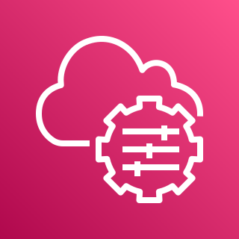





EC2 Internals
Security group
“point & click firewall”
CW Agent
AWS Systems Manager
Amazon CloudWatch
SSM Agent
NAT gateway
Inspector
Elastic network interface
EC2 Instance
H/W ½ (instance type)
S/W ½ (Amazon Machine Image) or “AMI”
May have local (ephemeral) disk
At least one NIC card (ENI)
EBS Volume
Elastic IP address
Amazon Inspector

Slide 43
Challenges of EC2
No native AWS API access to internals of server!
AWS Systems Manager (SSM) can help.
Limited CloudWatch visibility into internal metrics (no RAM utilization metric, for example).
Unique security concerns:
Remote access via SSH / RDP (probably biggest attack vector).
Ongoing patching (of OS, packages) required.
Need permissions to interact w/other AWS services.
It’s “true” IaaS. Wait… what’s IaaS?

Slide 44
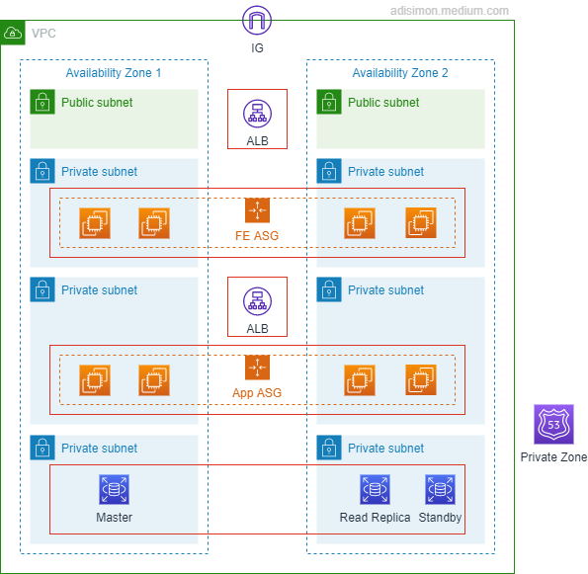
IaaS -vs- PaaS -vs- SaaS
Software aaS – think Office 365, Salesforce G’Apps…
Control Convenience
“non-tecchies point and click to configure app”
AWS Web Console!
Platform aaS – GCP & Azure started here
“Point and click custom app deployment & mgmt”
AWS: Elastic Beanstalk
Infrastructure aaS – 95% of what AWS offers is this!
“lego building blocks” -- You gotta know intricacies of each piece
But some folks say only “VMs” (AWS: EC2) are IaaS… I disagree, BTW…

Slide 45
Value Props: EC2 -vs- Containers -vs- Lambda
100 users
EC2 – “t2.nano”
20-30 sec
# of users served
10 users
Containers (ECS/EKS)
2-3 sec
< Sec
1 user
Serverless (Lambda)
response time
T₀ – Signal to Scale

Slide 46
EC2 Ecosystem
Internet
VPC
Internet gateway
Availability Zone 1
Availability Zone 2
NAT gateway
NAT gateway
Public subnet
Public subnet
Route table
Application Load Balancer
Route table
NAT Gateway
NAT Gateway
Auto Scaling group
Private subnet
Private subnet
Route table
Route table
EC2 Instance
EC2 Instance

Slide 47
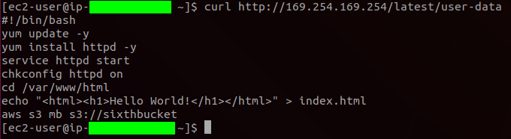
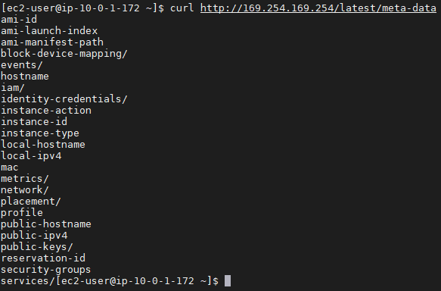
User Data & Instance Metadata

Slide 48
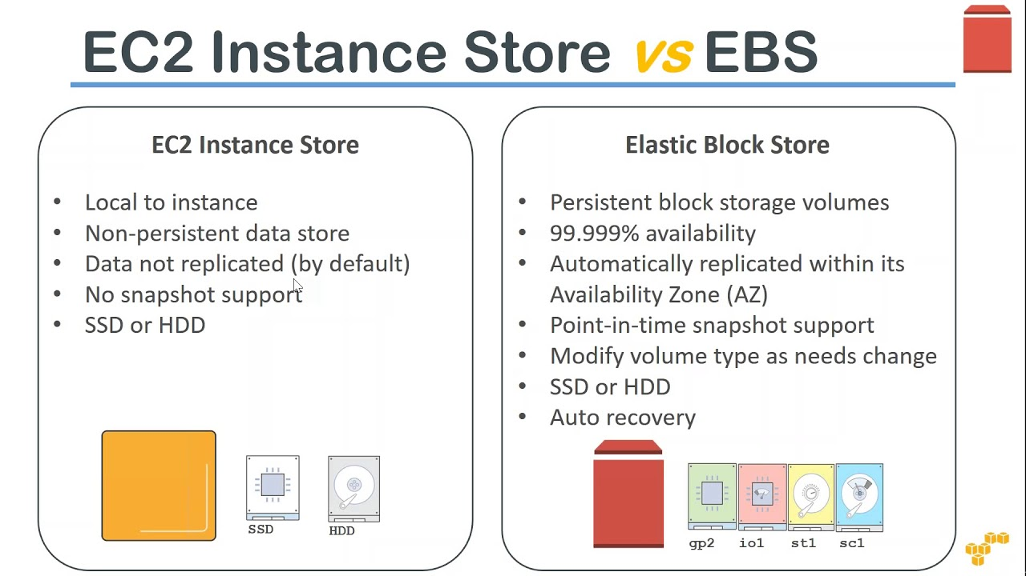

Slide 49









AWS Systems Manager
Automation
Documents
Patch Manager
Parameter Store
Run Command
Inventory
Maintenance Windows
State Manager
…And LOTS More
OpsCenter

Slide 50
Amazon Inspector
“Automated , continual vulnerability management at scale”
Agent-based (white box) and agent-less (black box)
Works with EC2, Containers
Calculates contextualized “risk score” based on CVE info
Has own console, and Security Hub integration
Can be used with EventBridge to automatically generate tickets and start remediation workflows
Notes:
https://aws.amazon.com/inspector/?nc=sn&loc=0

Slide 51

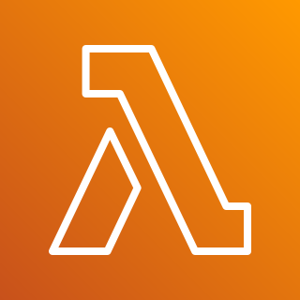

AWS Secrets Manager
“Rotate, manage, retrieve DB creds, API keys and other secrets”
Very useful for database credentials
Secrets Manager
Creds Rotation
App
EC2/OP svr
Database
Notes:
AWS Security Blog on using lambda with Secrets Manager & credentials rotation: https://aws.amazon.com/blogs/security/how-to-securely-provide-database-credentials-to-lambda-functions-by-using-aws-secrets-manager/

Slide 52

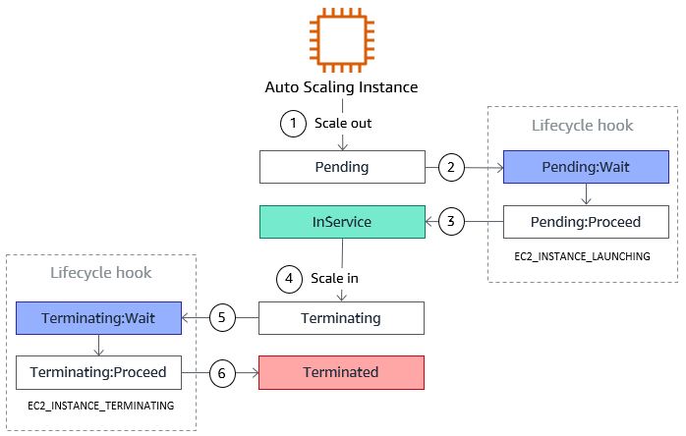
EC2 Auto Scaling Lifecycle Hooks
Used for:
Bootstrapping
Notifications
Cleanup

Slide 54
S7: Lambda & Containers
Lambda
Advantages of Serverless
Lambda basics
Containers
Utility in decomposing a monolith

Slide 55
Value props of Serverless
No “care and feeding” of infrastructure
Patching
Security
Monitoring
Networking
Scaling (Vertical -or- Horizontal)
Serverless architectures let you focus on your product, not your infrastructure.

Slide 56
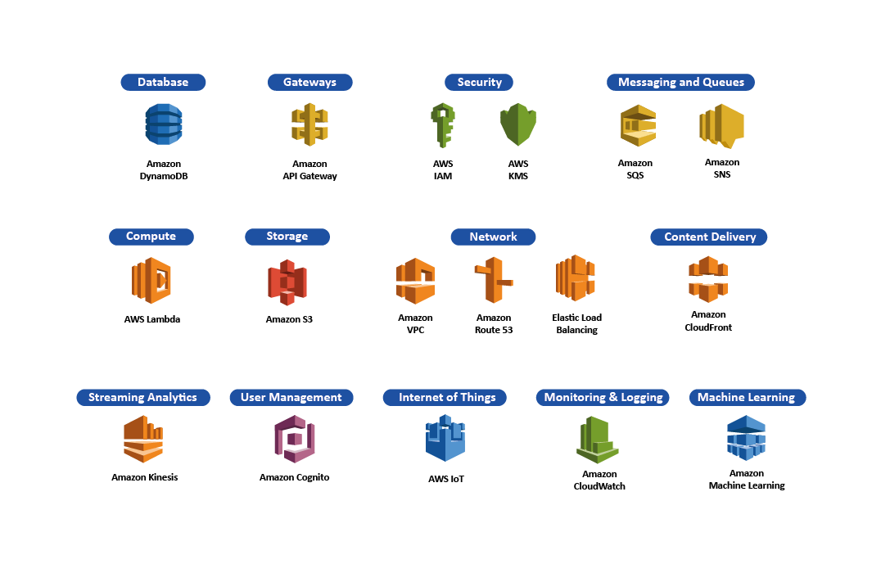
AWS Serverless Platform

Slide 57
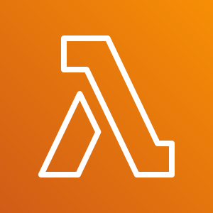
Lambda use cases
Automation! Security, GRC, DevOps, Operations, CI/CD… (Gee, if only someone taught a relevant, soup-to-nuts, up-to-date class… like in the next month… for free… if only…)
Target for ALB function calls
Target for EventBridge triggers
Cron-jobs
State machines (via Step Functions)

Slide 58
Lambda Limitations & Limits
Can’t serve 3rd party apps (like Wordpress, MySQL, etc)
Both Containers & EC2 *can*, btw…
Lambda functions must execute in < 15mins
Though multiple Lambda functions can be tied together with Step Functions.
Lambda functions must consume < 10GB of memory
Invocation payload must be under 6MB
There are limitations around ports (like no SMTP) & low-level kernel calls.
Notes:
NOTE: AWS frequently changes limits around things like execution time & memory consumption. For the full list of current limits for AWS Lambda, check https://docs.aws.amazon.com/lambda/latest/dg/gettingstarted-limits.html

Slide 59





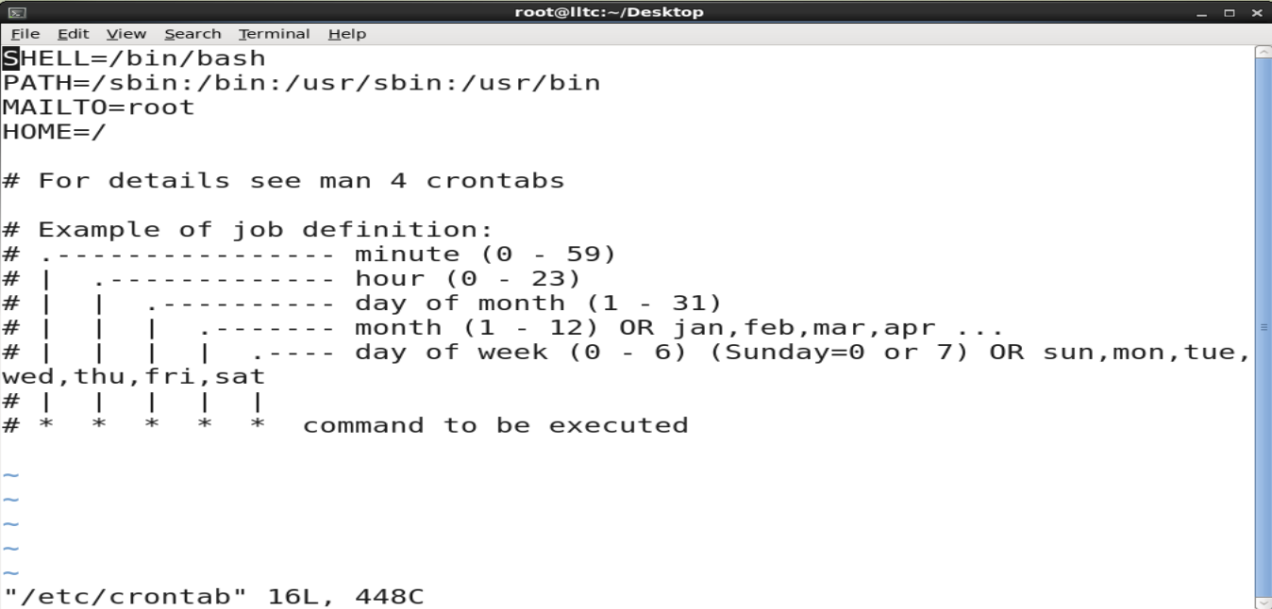
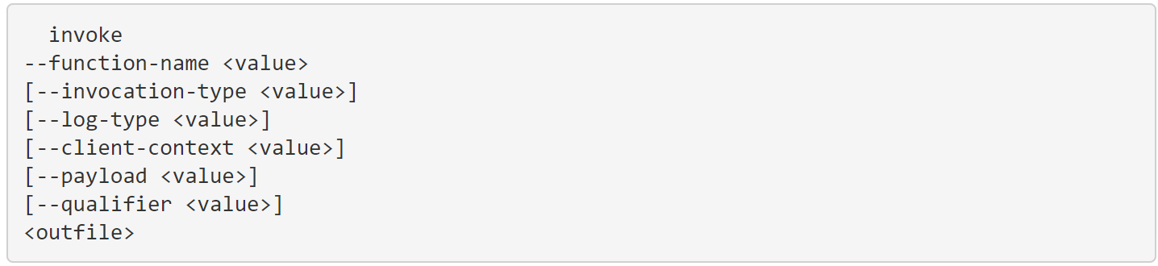
Lambda Invocation Methods
1) PUSH
“Hey Lambda, here’s some data”
2)PULL/POLL
“Hey <Svc X>, Have any data for me?”
Event Notifications
S3
SQS
SQS: GetRecords API Call
Lambda trigger
Lambda
Lambda
Lambda Subscription
SNS
DynamoDB Streams
3) SCHEDULED ACTION
4) DIRECT INVOCATION
-OR-
Can be synchronous or asynchronous
https://docs.aws.amazon.com/cli/latest/reference/lambda/invoke.html
Native Reoccuring
Raw crontab

Slide 60
IAM permissions for Lambda
Event Notifications
S3
Requires Lambda invoke permissions
Lambda
DDB:PutItem(x)
“upstream svc invoking lambda”
DynamoDB
Requires Lambda execution role
Lambda Resource-side Policy:
“lambda executing API call on downstream svc”
"Statement": [
{
"Effect": "Allow",
"Principal": { "Service": "s3.amazonaws.com" },
"Action": "lambda:InvokeFunction",
"Resource": "arn:aws:lambda:us-east-2:123456789012:function:my-function",
"Condition": {
"StringEquals": { "AWS:SourceAccount": "123456789012" },
"ArnLike": { "AWS:SourceArn": "arn:aws:s3:::my-bucket" }
}
}
]
Roles have 2 parts:
Role with PD (permission)
Trust relationship to allow principal (Lambda) to assume role
Notes:
For more info on Lambda execution roles, see https://docs.aws.amazon.com/lambda/latest/dg/lambda-intro-execution-role.html

Slide 61
Lambda Execution role for DDB
Role with PD (permission)
Trust relationship (trust-policy.json)
{
"Version": "2012-10-17",
"Statement": [
{
"Effect": "Allow",
"Action": [
"dynamodb:PutItem",
"logs:CreateLogGroup",
"logs:CreateLogStream",
"logs:PutLogEvents",
],
"Resource": "*"
}
]
}
{
"Version": "2012-10-17",
"Statement": [
{
"Effect": "Allow",
"Principal": {
"Service": "lambda.amazonaws.com“
},
"Action": "sts:AssumeRole“
}
]
}
aws iam create-role --role-name lambda-ex \n
--assume-role-policy-document file://trust-policy.json
aws iam attach-role-policy --role-name lambda-ex --policy-arn arn:aws:iam::aws:policy/service-role/NameOfLambdaRoleYouCreatedInStep1

Slide 62
Anatomy of a Lambda Function
def lambda_handler(event, context):
message = 'Hello {} {}!'.format(event['first_name'], event['last_name’])
return {
'message' : message
}
event: contains event data, like html form data. Example:
{ "first_name": "John", "last_name": "Smith" }
Would Return:
{ "message": "Hello John Smith!" }
context: provides info about the invocation, function & execution environment. Example:
print("Lambda function ARN:", context.invoked_function_arn)
print("CloudWatch log stream name:", context.log_stream_name)
print("CloudWatch log group name:", context.log_group_name)
print("Lambda Request ID:", context.aws_request_id)
print("Lambda function memory limits in MB:", context.memory_limit_in_mb)
# We have added a 1 second delay so you can see the time remaining in get_remaining_time_in_millis. time.sleep(1)
print("Lambda time remaining in MS:", context.get_remaining_time_in_millis())
Handler: the entry point where you function starts processing.
Note on naming: Handler name is derived from:
The name of the file in which the handler function is located
The name of the Python handler function.
Default name in the console is just “lambda_handler”.
IMPORTANT: Code inside than handler is executed on each function call, code outside the handler is executed only on “cold starts” (Luckily for us, Python and Node.js are the fastest to start)
Notes:
Python handler examples from AWS Documentation at https://docs.aws.amazon.com/lambda/latest/dg/python-handler.html
Context examples from AWS Documentation at https://docs.aws.amazon.com/lambda/latest/dg/python-context.html
Details on cold starts: https://dashbird.io/knowledge-base/aws-lambda/cold-starts/

Slide 63
Review of Lambda Basics
Lambda can work with *any* language via containers
Can (and should) use Layers to include external packages
Reusable
Allow centralized, common control over packages
Reduce deployment package size
All code & dependencies contained in a zipfile
State Machines (combining multiple Lambdas & other svcs) can be constructed from AWS Step Functions

Slide 64
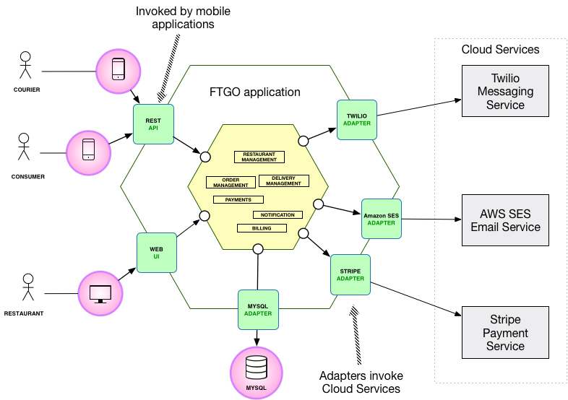
Using Containers to “Strangle the Monolith”

Slide 65
Logging Services in AWS
CloudTrail: Logs all GA’d service API calls
Access Logs:
S3
ELB (Application and Network Load Balancers only)
CloudFront CDN
API Gateway
KMS
NOTE: ALL of these logs must be turned on!

Slide 66
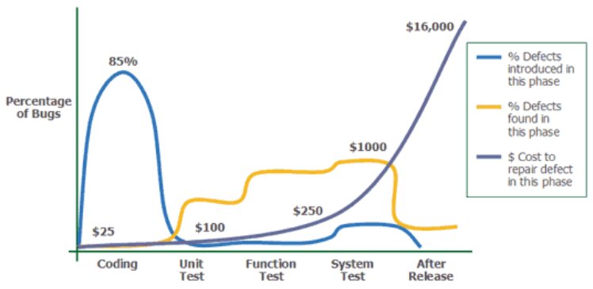

“Shift left” – the whole point of CI/CD
Source: Applied Software Measurement, Capers Jones, 1996
Notes:
Image credit: https://medium.com/at-internet/how-to-combine-testing-and-agile-method-2a990d70108f
…and if you want to read more from Capers Jones, here’s a link to his catalog on Amazon.com: https://www.amazon.com/Capers-Jones/e/B000APTHHW%3Fref=dbs_a_mng_rwt_scns_share

Slide 67

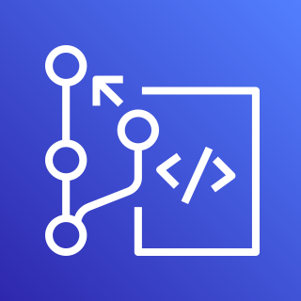

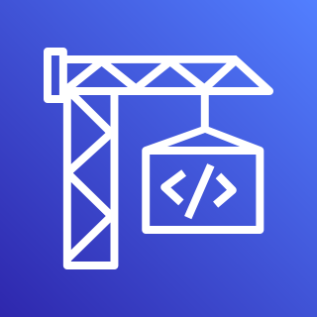
DevSecOps
1.
2.
3.
Developers
AWS CodeCommit
Lambda Security
Checks
AWS CodeBuild
Code Commited
Secrets (AK/SK, etc) sniff
Static Code Analysis
Look up Config (possibly tag-based)
Enforce WAF rules
Enforce SG policies
Enforce ELB Security
Enforce VPC setup
…and more!
Continue Build, Test, Deploy…

Slide 68
S8: Databases
Differences of SQL vs NoSQL
RDS
Basic Usage
Database Engines
Deep-dive in Postgres
DynamoDB
Basics
Advanced usage (global tables, FGAC, GSIs, LSIs, etc)

Slide 69
Architecture
Internet
Internet gateway
VPC
Availability Zone 1
Availability Zone 2
NAT Gateway
NAT Gateway
Route table
Public subnet
Application Load Balancer (running WAF)
Public subnet
Route table
Auto Scaling group
EC2 Instance*
EC2 Instance*
Route table
Private subnet
Private subnet
Route table
RDS instance
primary
RDS instance
2ndary
Synchronous Replication
Route table
Route table
Protected subnet
Protected subnet
* - Could be running Lambda -OR- Containers in place of EC2
Notes:
We’ll walk through this architecture, step-by-step throughout the day, hitting on the highlights as we peel back the covers to look at each component individually.

Slide 70
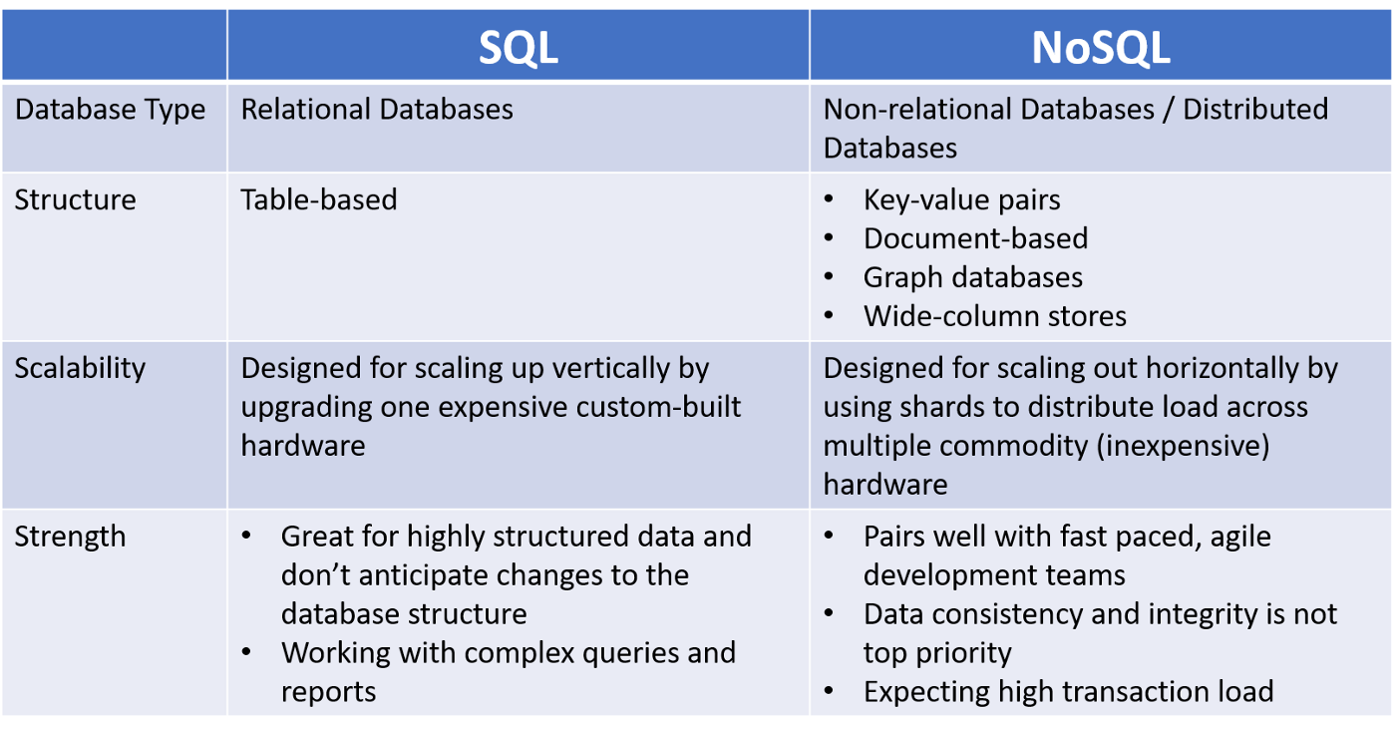
Data Layer Options

Slide 71
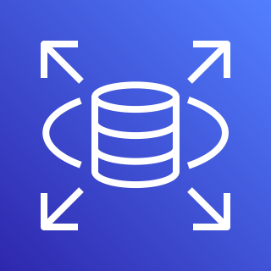
RDS: High Level
Many Engine Types (Oracle, Postgres, Aurora, etc)
“Semi”-managed
Vertically & Horizontally (Read-replicas, 2ndary) scalable
Deploy to the VPC
Use SGs just like EC2
Backups, Snapshots, etc are checkbox operations
All 2ndary replicas are synchronous

Slide 72
RDS PostgreSQL Deep Dive
JSON querying language supported (since 9.2)
Partitioning improvements
Configuration parameters

Slide 73
DynamoDB
Useful for “3Vs” issues
<ms responses at any volume or velocity (given proper r/w provisioning)
No Limits: On table size; On row (we call them “items”) count
Use this when you expect:
Tremendous growth
Lots of changes in the data model (adds/deletes of colums – we call them “attributes”)
Can run as K-V store, Document data store
Can be queried via PartiQL (a SQL-like querying engine)

Slide 74
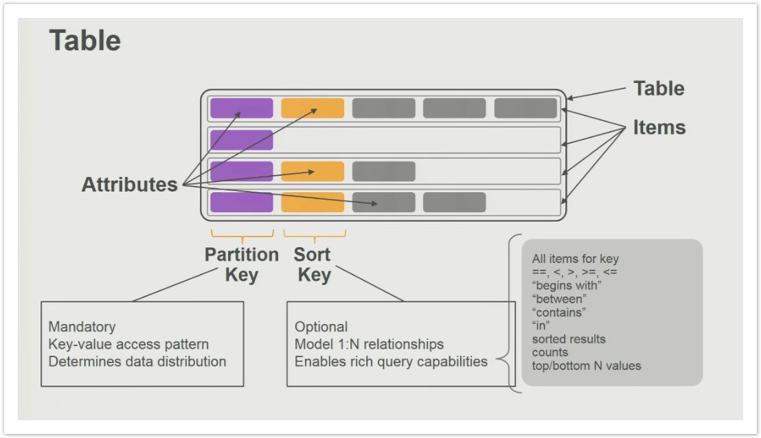
DDB Terminology

Slide 75
DDB: Advanced Usage
GSI: 20/Table
LSI: 5/Table
Global Tables
Fine Grained Access Control
DDB Streams

Slide 76
DDB Streams
Can be enabled after table creation
Allow real-time alerting of any table updates (CUD of items, attributes)
Can hook lambda function to stream to allow handling of events such as customer churn, order handling, etc
Enables Global Tables

Slide 77
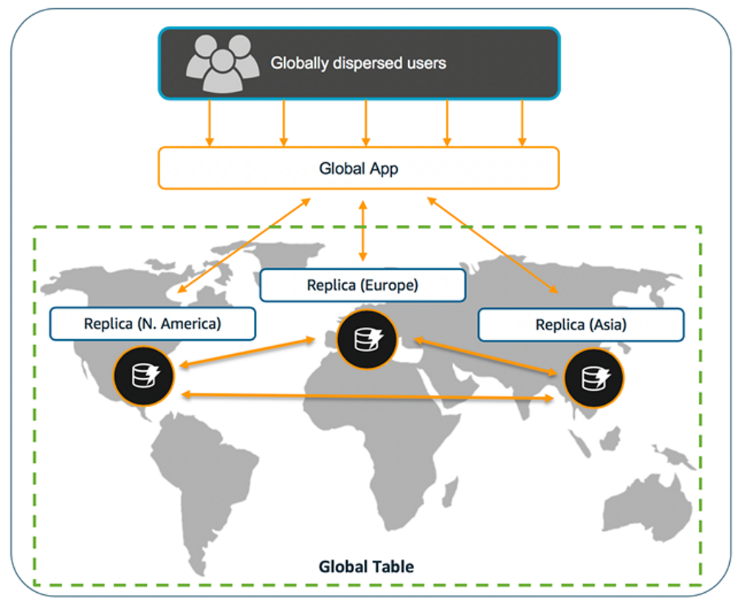
DDB Global Tables

Slide 78
DDB Fine Grained Access Control (FGAC)
Allows locking of individual attributes to individual IAM users
For example, block sensitive info like SSN from all users but super admin view (all others see obfuscated “*****”)

Slide 79


